Slide 1

ENGINEERING CHEMISTRY
Department of Science and Humanities

Slide 2

ENGINEERING CHEMISTRY
Module I- COMPUTATIONAL CHEMISTRY
SCOPE
COST
EFFICIENCY OF COMPUTATIONAL MODELING.

Slide 3
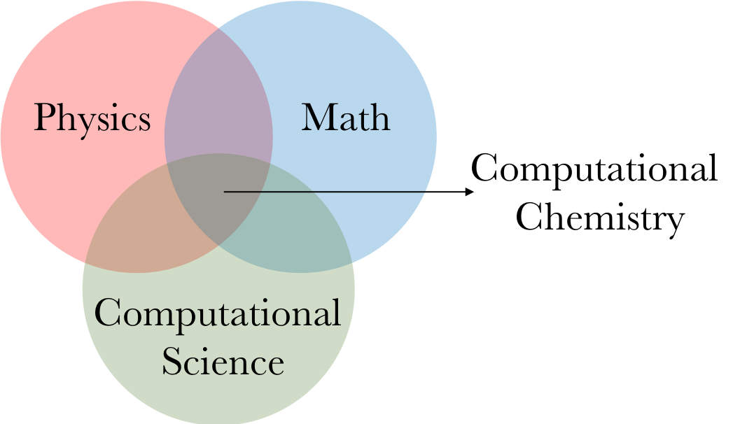
ENGINEERING CHEMISTRY
Module I- COMPUTATIONAL CHEMISTRY
Introduction
Computational chemistry is a set of techniques for the investigating chemical problems on a computer rather than using chemicals.
It uses the results of theoretical chemistry incorporated into efficient computer programs to calculate the properties of a molecule.
The first theoretical investigation was done by Walter Heitler and Fritz London in 1927

Slide 4
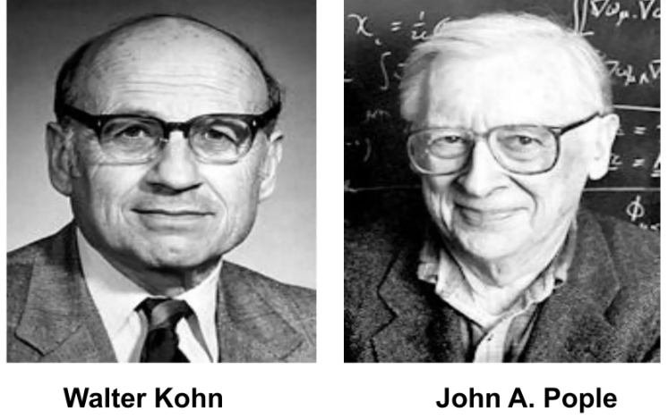
ENGINEERING CHEMISTRY
Module I- COMPUTATIONAL CHEMISTRY
1998
Walter Kohn : For the development of density functional theory.
John A. Pople : For the development of computational methods in quantum chemistry.

Slide 5
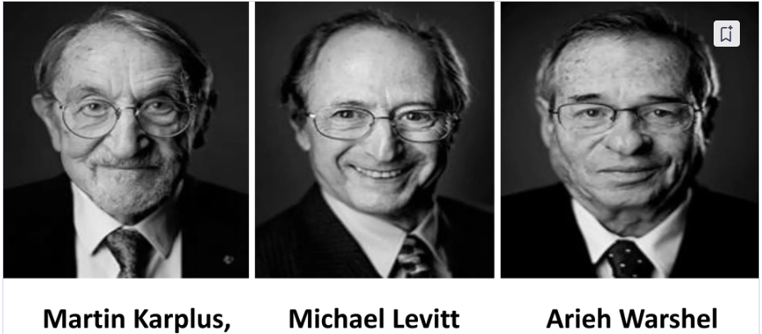
ENGINEERING CHEMISTRY
Module I- COMPUTATIONAL CHEMISTRY
2013
For the development of computer based methods to model complex systems.

Slide 6
ENGINEERING CHEMISTRY
Module I- COMPUTATIONAL CHEMISTRY
Objective of computational chemistry:
To solve chemistry problems by simulating chemical systems ( molecular, biological, materials) to provide reliable, accurate and comprehensive information at an atomic level.
Advantages of computational chemistry:
Calculations are easy to perform than carrying experiments.
Calculations are less costly, whereas experiments are becoming more expensive
Calculations are safe than performing experiments.

Slide 7
ENGINEERING CHEMISTRY
Module I- COMPUTATIONAL CHEMISTRY
Scope of computational modeling:
Molecular Properties:
Computational modeling can be used to accurately predict the physical and chemical properties of molecules, such as
Bond lengths,
Bond angles
Molecular orbital energies (HOMO/LUMO)
Can predict the spectra of UV-Vis, IR and NMR
Thermodynamic and kinetic properties
Electronic structure and mechanical properties

Slide 8
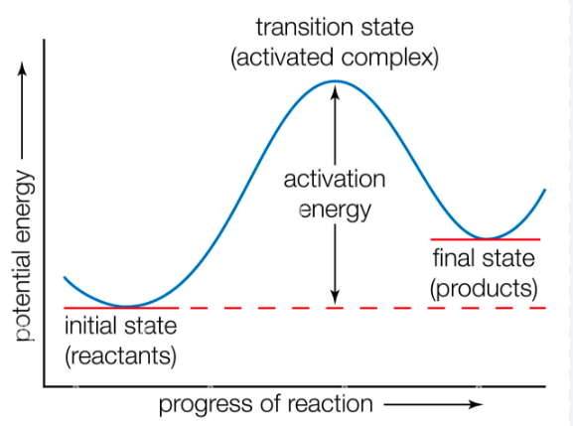
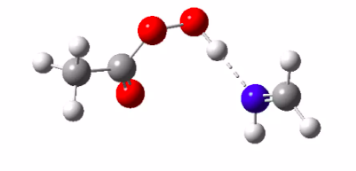
ENGINEERING CHEMISTRY
Module I- COMPUTATIONAL CHEMISTRY
Reaction mechanism:
To know the underlying reaction mechanism and the kinetics of a reaction mechanism computational chemistry plays a vital role.
Material design:
Computational modeling enables the rational design of new materials with desired properties such as high electrical conductivity, thermal stability etc. This leads to the development of advanced materials for energy production and storage applications, electronics and much more.

Slide 9
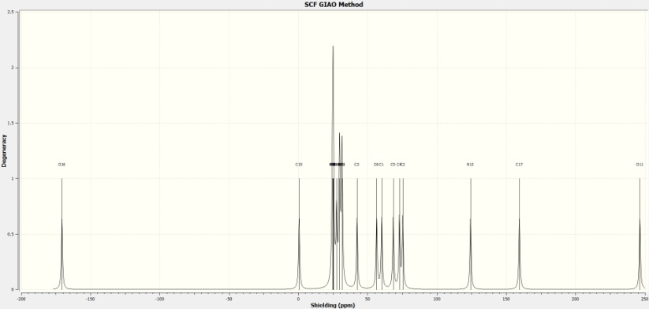
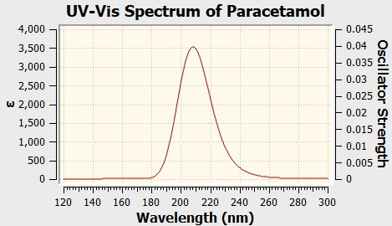
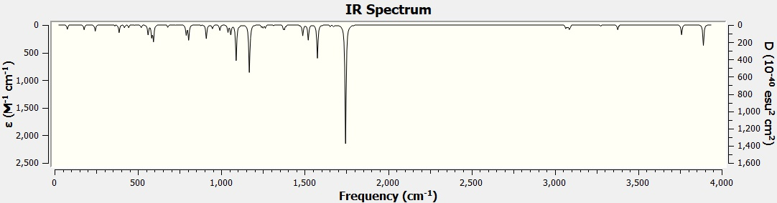
ENGINEERING CHEMISTRY
Module I- COMPUTATIONAL CHEMISTRY
Drug discovery:
Computational chemistry plays a pivotal role in design and screening of potential drug candidates by simulating the interactions between the drug molecules and biological targets.
Paracetamol

Slide 10
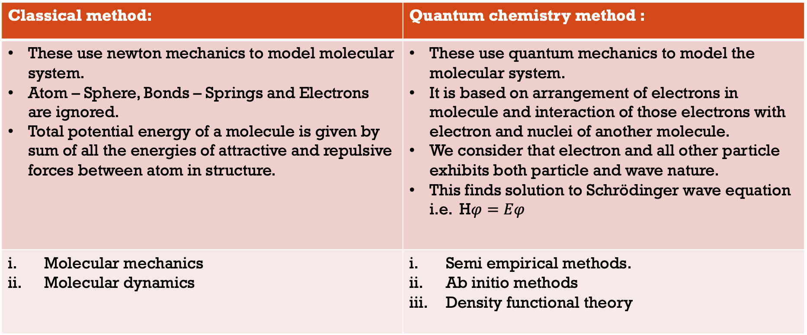
ENGINEERING CHEMISTRY
Module I- COMPUTATIONAL CHEMISTRY
Computational methods:
There are two main methods depending on the starting point theory:
Classical method: | Quantum chemistry method :
These use newton mechanics to model molecular system. Atom – Sphere, Bonds – Springs and Electrons are ignored. Total potential energy of a molecule is given by sum of all the energies of attractive and repulsive forces between atom in structure.
Molecular mechanics Molecular dynamics | Semi empirical methods. Ab initio methods Density functional theory

Slide 11
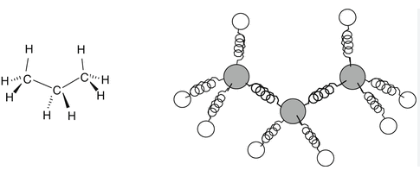
ENGINEERING CHEMISTRY
Module I- COMPUTATIONAL CHEMISTRY
Molecular mechanics:
Molecular mechanics programs use equations based on classical physics to calculate force fields.
It is based on the model of a molecule as a collection of balls( atoms) held together by springs(bonds).
By knowing the spring lengths, their angles, and how much energy it takes to stretch and bend the springs, we can calculate the energy of a given molecule.
Its too fast like a very large molecules like steroids can be optimized in seconds.
It allows geometry optimization .

Slide 12
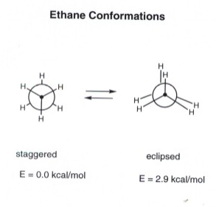
ENGINEERING CHEMISTRY
Module I- COMPUTATIONAL CHEMISTRY
Molecular dynamics:
Molecular dynamics is a molecular mechanics program designed to mimic the movement of atoms within a molecule. The laws of motion to molecule is the base for it..
Molecular dynamics can be carried out on a molecule to generate different conformation which on energy minimization, give a range of stable conformation. Alternatively, bonds can be rotated in a stepwise process to generate different conformation.
Molecular dynamics can also be used to find minimum energy structures and conformational analysis.

Slide 13
ENGINEERING CHEMISTRY
Module I- COMPUTATIONAL CHEMISTRY
Semi empirical methods:
Semi empirical calculations are based on Schrödinger equation.
It represents a middle road between the mostly qualitative results available from molecular mechanics and the high computationally demanding quantitative results from Ab initio methods.
Capable of calculating transition states and excited states.

Slide 14
ENGINEERING CHEMISTRY
Module I- COMPUTATIONAL CHEMISTRY
Ab initio calculations:
Ab initio calculations are based on Schrödinger equation.
This is one of the fundamental equations of modern physics and it describes, among other things, how the electrons in a molecule behave.
It solves Schrödinger equation of a molecule and give us energy and wave function.
The wave function is a mathematical function that can be used to calculate the electrons distribution.
The challenge in computational chemistry is to simplify the calculations enough to be solvable, but still accurate enough to predict the physical quantity.

Slide 15
ENGINEERING CHEMISTRY
Module I- COMPUTATIONAL CHEMISTRY
Density functional theory
DFT are like Ab initio and semi empirical calculations, based on Schrödinger equation.
However, unlike the other two methods, DFT does not calculate a conventional wave function , but rather derives the electron distribution directly.
This functional here is a mathematical entity related to a function.
Density functional calculations are usually faster than Ab initio, but slower than semi empirical method.

Slide 16
ENGINEERING CHEMISTRY
Module I- COMPUTATIONAL CHEMISTRY
Applications of computational chemistry.
Electronic structure predictions.
Geometry optimizations or energy minimizations.
Conformational analysis and potential energy surfaces.
Finding transition structure and reaction paths and molecular docking: protein – protein, protein – ligand interactions.
Electron charge distribution calculations.
Calculation of rate constants for chemical reactions : chemical kinetics.
Thermochemistry : heat of reactions, energy of activation, etc.
Calculation of many other molecular, physical and chemical properties.
Electronic excitation energy.
Orbital energy levels and electron density all these can be performed or calculated.

Slide 17
ENGINEERING CHEMISTRY
Module I- COMPUTATIONAL CHEMISTRY
Challenges and Limitation
Accuracy
Ensuring the reliability and precision of computational predictions is an ongoing challenge.
Computational Cost
Highly complex simulations can require significant computational resources and time.
Validation
Experimental data is essential for validating and refining computational models.
Interdisciplinary
Effective computational chemistry requires collaboration across multiple scientific disciplines.

Slide 18
ENGINEERING CHEMISTRY
Module I- COMPUTATIONAL CHEMISTRY
Cost consideration in computational modeling
Software aspect
Hardware aspect
Computational chemistry expert (computational chemist)

Slide 19
ENGINEERING CHEMISTRY
Module I- COMPUTATIONAL CHEMISTRY
Computational chemistry plays a pivotal role in advancing our understanding of chemical systems and accelerating scientific discovery.
Its advantages in cost-effectiveness, efficiency, safety, accessibility, versatility, and accuracy make it an indispensable tool in modern research and development.
Computational chemistry is not a replacement for experimental studies, but plays an important role in enabling chemists to
Explain: and rationalize known chemistry.
Explore: new or unknown chemistry.
Conclusion

Slide 20
THANK YOU
Department of Science and Humanities

